Slide 1
Meta-Analysis Method Summary

Slide 2
What is a meta-analysis?
Systematic review and statistical methods to combine and summarize the results of several independent studies
Provides precise estimate of the effect size of specific intervention or exposure, by pooling results of multiple studies that investigated the same research question
Statistical analysis that combines results of two or more studies to estimate pooled effect size
Analyzing data from previous studies to identify patterns and draw conclusions
Measures variability among the studies results, CI, I^2 test
Notes:
Meta-analysis is a statistical tool for estimating the mean and variance of underlying population effects from a collection of empirical studies addressing ostensibly the same research question.

Slide 3
Why perform a meta-analysis?
1. Get a quantitative overview of a research field
Estimate the size of the effect
Increase power by synthesizing data across studies
Gradual measure to evaluate results
Weight effect sizes
Accounting for differences in precision (sample sizes and variability)
Identify critical moderator variables
Identify variability not evident from a single study
2. Inform design of new research
Do prospective power calculations
Empirically motivated sample size calculations
Decide experiment design parameters
E.g. choose methods with the highest success rate

Slide 4
Meta-analysis steps
Define research questions
Literature search
Studies inclusion based on criteria
Selection of specific studies
Draw PRISMA chart
Select effect size measure
Hedges’s
Cohen’s d
OO, RR, Rate
Correlations (r)
Selection of meta-analysis model
Fixed effect
Random effects
Heterogeneity test (I^2)
Overall effect size
Draw forest plot
Notes:
PRISMA – Preferred Reporting Items for Systematic reviews and Meta-Analysis, which is a set of guidelines and standards for reporting systematic review and meta-analysis in medical research

Slide 5
Dataset Selection - PRISMA Chart
Dataset records through database search (n = 100+)
Access availability (n = 87)
Dataset excluded (n = 50)
Record after remove duplicate (11)
Record excluded ( n = 71)
Notes:
Web of science

Slide 6
Effect Size
Statistical measure quantifies
Magnitude or strength of relationship between variables
Difference between the two groups
Measures how large the difference between two groups
Likelihood of event occurring in one group relative to another group
Provides a standardized way to evaluate the significance observed effect in a study or experiment
Determine extent to which independent variable (treatment or intervention) influences dependent variable (outcome)
A larger effect size suggests a stronger relationship or larger difference between variables
Effect sizes are combined from multiple studies to produce an overall estimate of the effect size in meta-analysis

Slide 7
Common Type of Effect Size
Standardized mean difference (SMD)
Used when combined studies measure the same variable but use different units of measurement
Calculated by dividing the difference between the means of two groups by the pooled standard deviation of the two groups
Odds ratio (OR)
Use when the outcome variable is binary
Represent the odds of an event happening in one group relative to the odds of the event occurring in another group
Risk ratio (RR)
Used when the outcome variable is dichotomous
Study designs include a control group
Represent the risk of an event occurring in the treatment group relative to the risk of the event occurring in the control group
Correlation coefficient (r)
Used when combined studies measure the relationship between two continuous variables
Represent the strength and direction of the relationship between two variables

Slide 8



Fixed-Effect Model Calculation Steps
Step 1: Determine the weights for each study:
Step 2: Calculate the weighted mean effect size:
Step 3: Compute the SE of the weighted mean effect size:
Step 4: Calculate the 95% Confidence Interval:

Slide 9



Random-Effect Model Calculation Steps
Step 1: Calculate Individual Study Variances:
Step 2: Calculate Weights for Fixed-Effect Model:
Step 3: Estimate Between-Study Variance (Tau-squared, τ2):
where:

Slide 10


Random-Effect Model Calculation Steps
Step 4: Calculate Weights for Random-Effects Model:
Step 5: Calculate the Weighted Mean Effect Size:
Step 6: Compute the Standard Error of the Weighted Mean Effect :
Step 7: Calculate the 95% Confidence Interval:

Slide 11
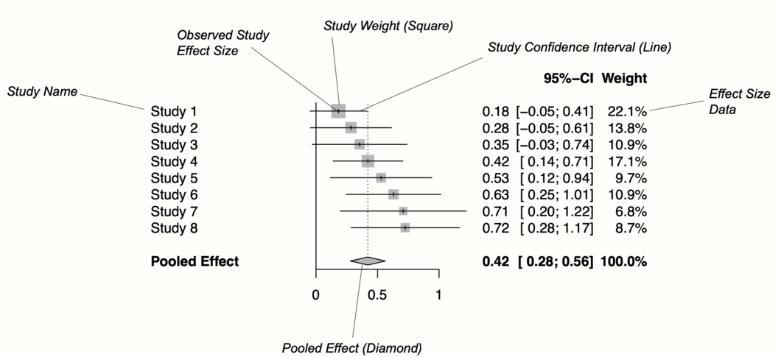
Forest Plot

Slide 12
Disadvantages of meta-analysis using aggregate data
Reliant on reporting of published articles
Not in control of the statistical analysis method used: inconsistency in choice of effect size
Vulnerable to publication bias: studies with significant results more likely to be published (or reported well) than non-significant studies
Vulnerable to outcome reporting bias – studies report only those outcomes that were significant or most interesting
Going beyond original analysis is very hard (often impossible)
Aggregate data collapses participant-level information

Slide 13
IPD meta-analysis: rationale & advantages
IPD: Individual Participant Data
The original, raw individual-level data from the primary studies identifies by the review
The original source of material, from which aggregate data are derived
IDP meta-analysis
The synthesis (in a statistical model) of the IPD from multiple studies for the purpose of summarising the evidence
Increasingly relevant with the advent of “stratified medicine” – the tailoring of treatment decisions for individual patients

Slide 14
Meta-analysis using IPD
Potential advantages
Use consistent inclusion and exclusion citeria across studies and if appropriate reinstate individuals into the analysis who were original excluded
Observe and account for missing data at the individual level
Verify results presented in the original study publications (assuming provided can be matched to that IPD used in the original analyses)
Inform risk bias assessments
Potential advantages
Use consistent inclusion and exclusion citeria across studies and if appropriate reinstate individuals into the analysis who were original excluded

Slide 15
Meta-analysis using IPD – 2 Stages Approach
First stage typically involves a standard regression analysis in each study separately to produce aggregate data, such as treatment effect estimate and their variances
Second stage uses well-known (e.g. inverse variance weighted) meta-analysis methods to combine this aggregate data and produce summary results and forest plots
Either a common-effect or random-effect model is assumed

Slide 16
Analysis Results on Churn Datasets

Slide 17
Methodology
Dataset Searching
Estimate Pooled and CI of Effect Size by Using Fixed & Random Effect Methods
Dataset Inclusion Exclusion Criteria
Derived Metrics Mean & Standard Error of ML algorithms for Each Datasets
Individual Dataset Processing
Predictive Models Evaluation
Notes:
Web of science

Slide 18
Datasets Summary
Dataset Names | Links | Entries | Features | Examples of Features | Common Features | Indexes
Telecom Customer Churn | MavenAnalytics | 7043 | 38 | Customer ID, Age, Gender, Services, Billing, Churn status | Customer demographics, service details, billing info, churn indicator | Customer ID
Internet Service Churn | Kaggle | 72274 | 11 | ID, TV/movie subscriptions, Service metrics, Churn | Service usage metrics, churn indicator | ID
Bank Customer Churn Records | Kaggle | 10000 | 18 | CustomerId, Credit Score, Geography, Balance, Churn status | Customer demographics, product usage, churn indicator | CustomerId
Credit Card Churn | Kaggle | 10127 | 21 | CLIENTNUM, Attrition_Flag, Demographics, Credit details, Transactions | Customer demographics, financial behavior, churn indicator | CLIENTNUM
E-commerce Churn | Kaggle | 5630 | 20 | CustomerID, Churn, Purchase metrics, App engagement | Customer engagement metrics, purchase details, churn indicator | CustomerID
Employee Churn | Kaggle | 1070 | 35 | Age, Department, Education, Job Level, Hourly Rate | employee's demographic background, job details, compensation, education, work experience, job satisfaction, and attrition status | EmployeeNumber
Telco Europa | Kaggle | 190776 | 20 | cetel_number', 'days_life', 'device_tecnology', 'price_plan', 'tot_min_call_out', 'churn' | customer’s usage patterns, service details, device and technology preferences, and churn status.
Telcom Cell2Cell | Kaggle | 71047 | 70 | Customer, Age, Churn, Phone,Model, Roam, Revenue | Customer Identification and Demographics, Subscription and Usage Metrics, Device and Equipment Metrics, Financial Metrics | customer
Membership Subcription | Kaggle | 10362 | 15 | 'membership_number', 'annual_fees', 'member_gender', 'member_annual_income', 'agent_code', 'membership_status' | membership term, financial obligations, member demographics, and associated agents | membership_number
Wireless Telecom South Asia | Kaggle | 2000 | 14 | network_age', 'Aggregate_Total_Rev', 'Aggregate_Data_Rev', 'Aggregate_Data_Vol', 'Aggregate_complaint_count' | Customer Lifetime, Revenue Metrics, Usage Metrics, Customer Preferences, Customer Support and Complaints
Nigeria Telecoms Churn | Kaggle | 1401 | 16 | network_age, Total Data Consumption, Total SMS Spend | Demographic Data, Usage Behavior, Financial Transactions, Service and Support Interactions | Customer ID

Slide 19
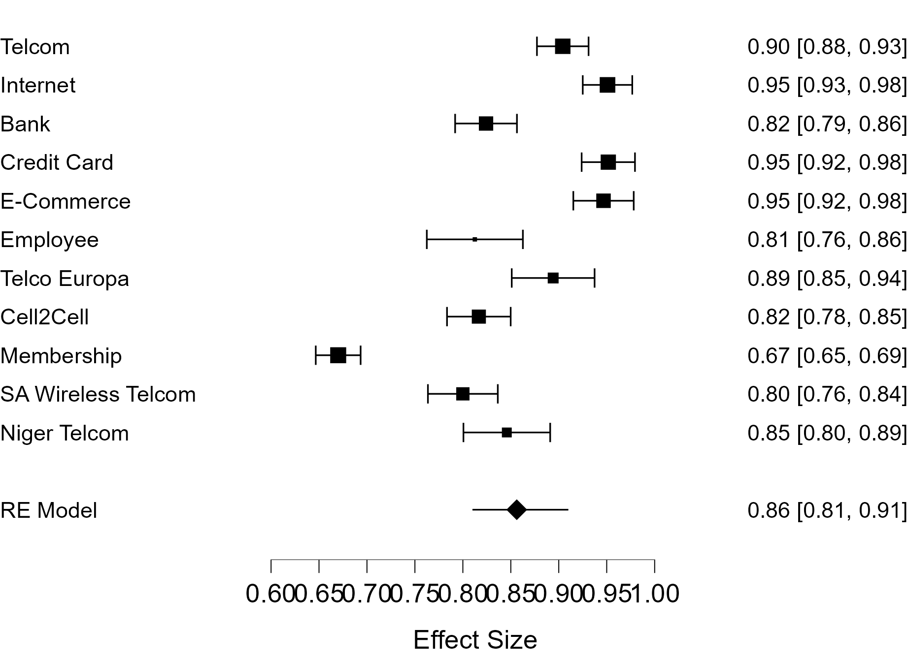
All Datasets – RE Model Forest Plot – AUC Mean

Slide 20
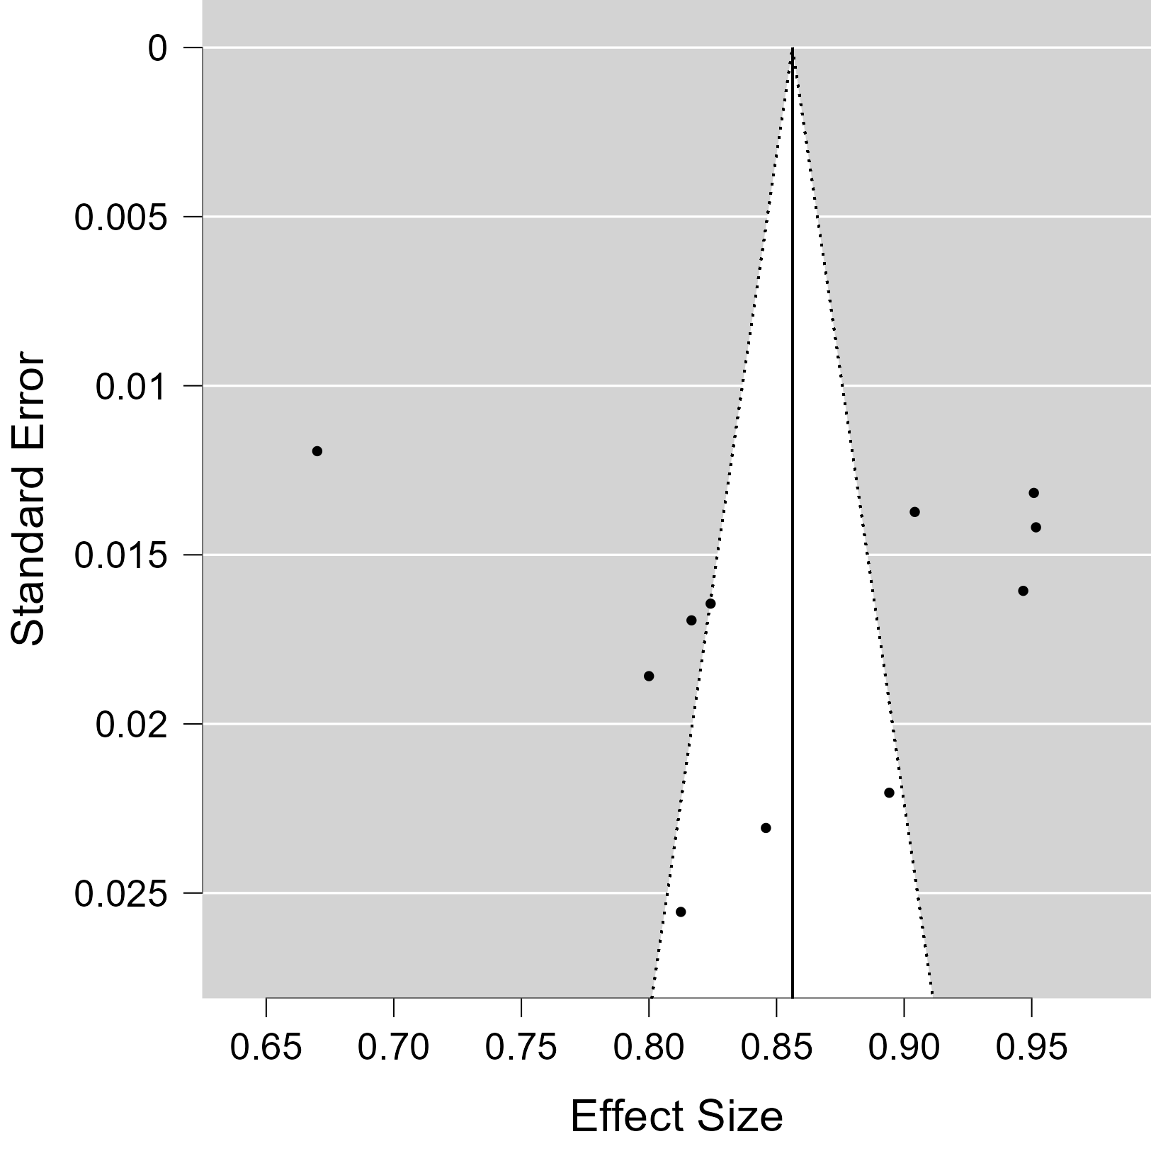
All Datasets – RE Model Funnel Plot
Notes:
Assessment of Bias: The funnel plot is used to visually assess bias in meta-analysis. Studies should ideally form a symmetrical funnel around the true effect size (typically near the narrow top). Asymmetry in this plot can indicate potential publication bias, where smaller studies that show no or negative results are less likely to be published. Alternatively, asymmetry could result from other biases such as methodological differences, true heterogeneity in study effects, or other factors.

Slide 21
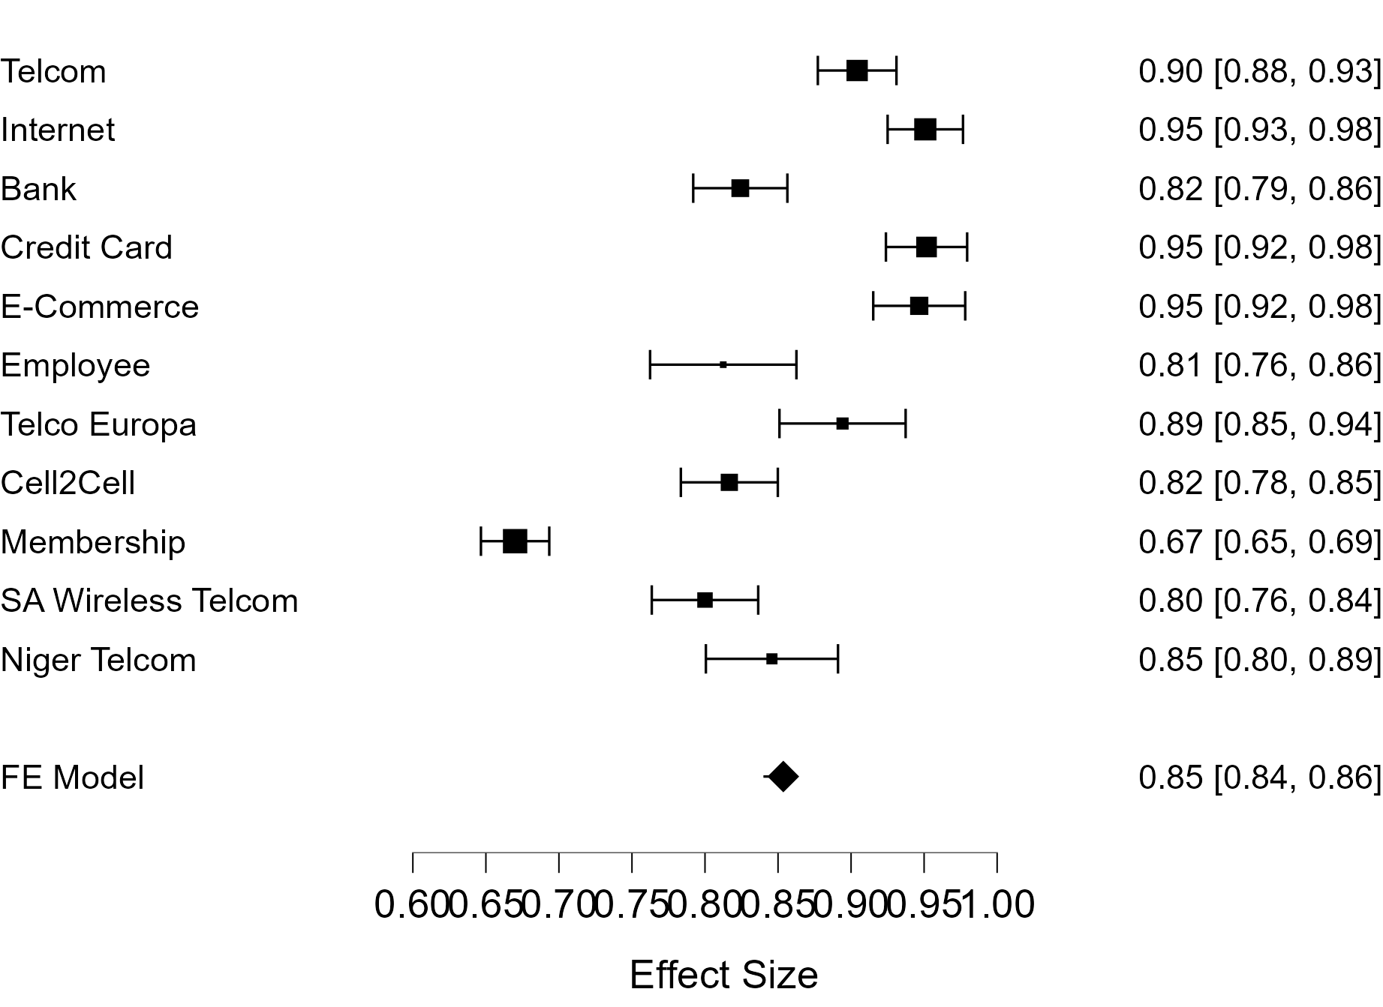
All Datasets – FE Model Forest Plot – AUC Mean

Slide 22
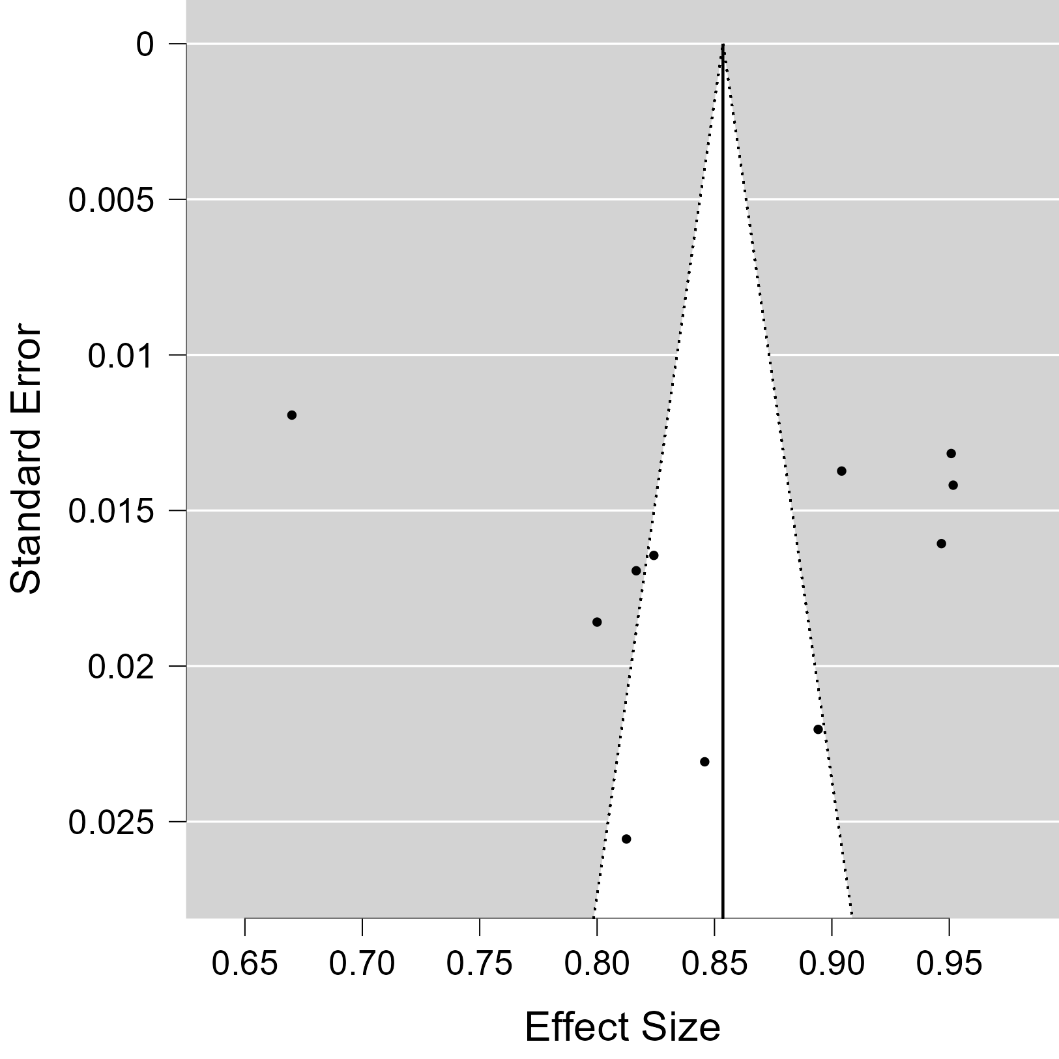
All Datasets – FE Model Funnel Plot

Slide 23
All Datasets – Fixed and Random Effects
Fixed and Random Effects
 |  | Q |  | df |  | p
Omnibus test of Model Coefficients |  | 1113.883 |  | 1 |  | < .001
Test of Residual Heterogeneity |  | 408.464 |  | 10 |  | < .001
Note. p -values are approximate.
Note. The model was estimated using Hedges method.
Notes:
The "Omnibus test of Model Coefficients" shows a statistic of 1113.883 with 1 degree of freedom and a very low p-value (less than 0.001), indicating strong evidence against the null hypothesis.
The "Test of Residual Heterogeneity" has a statistic of 408.464 with 10 degrees of freedom and a p-value less than 0.001, suggesting significant variability that is not accounted for by the model.

Slide 24
All Datasets – Residual Heterogeneity
Residual Heterogeneity Estimates
 |  | Estimate
τ² |  | 0.007
τ |  | 0.083
I² (%) |  | 96.328
H² |  | 27.231
Notes:
𝜏^2: This represents the between-study variance in the data, with an estimated value of 0.007.
𝜏: This is the square root of 𝜏^2, indicating the standard deviation of the true effects across studies, with a value of 0.083.
I^2 (%): This statistic measures the percentage of total variation across studies that is due to heterogeneity rather than chance. Here, it is calculated to be 96.328%, indicating high heterogeneity.
𝐻^2: This is the ratio of the total amount of heterogeneity to the amount expected due to sampling error alone, with a value of 27.231.

Slide 25
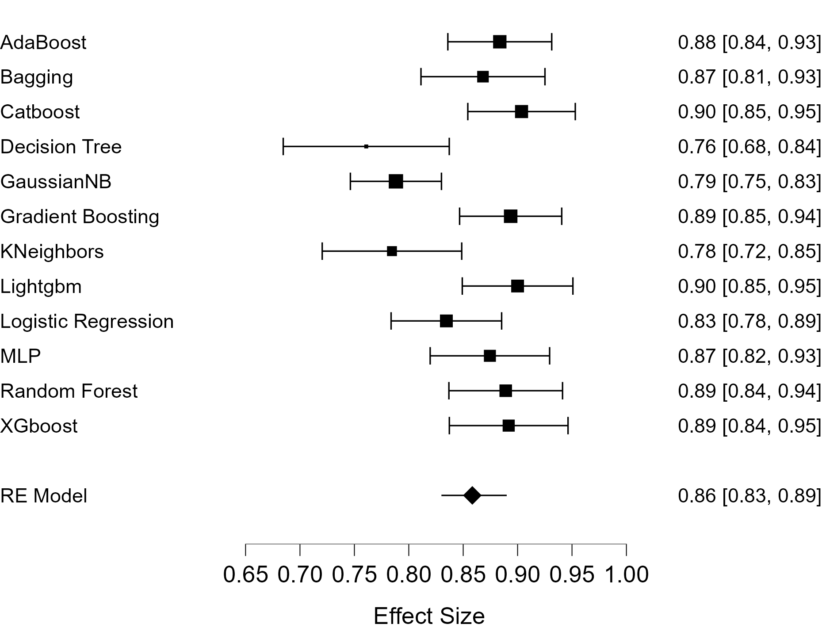
All Models – RE Model Forest Plot – AUC Mean

Slide 26
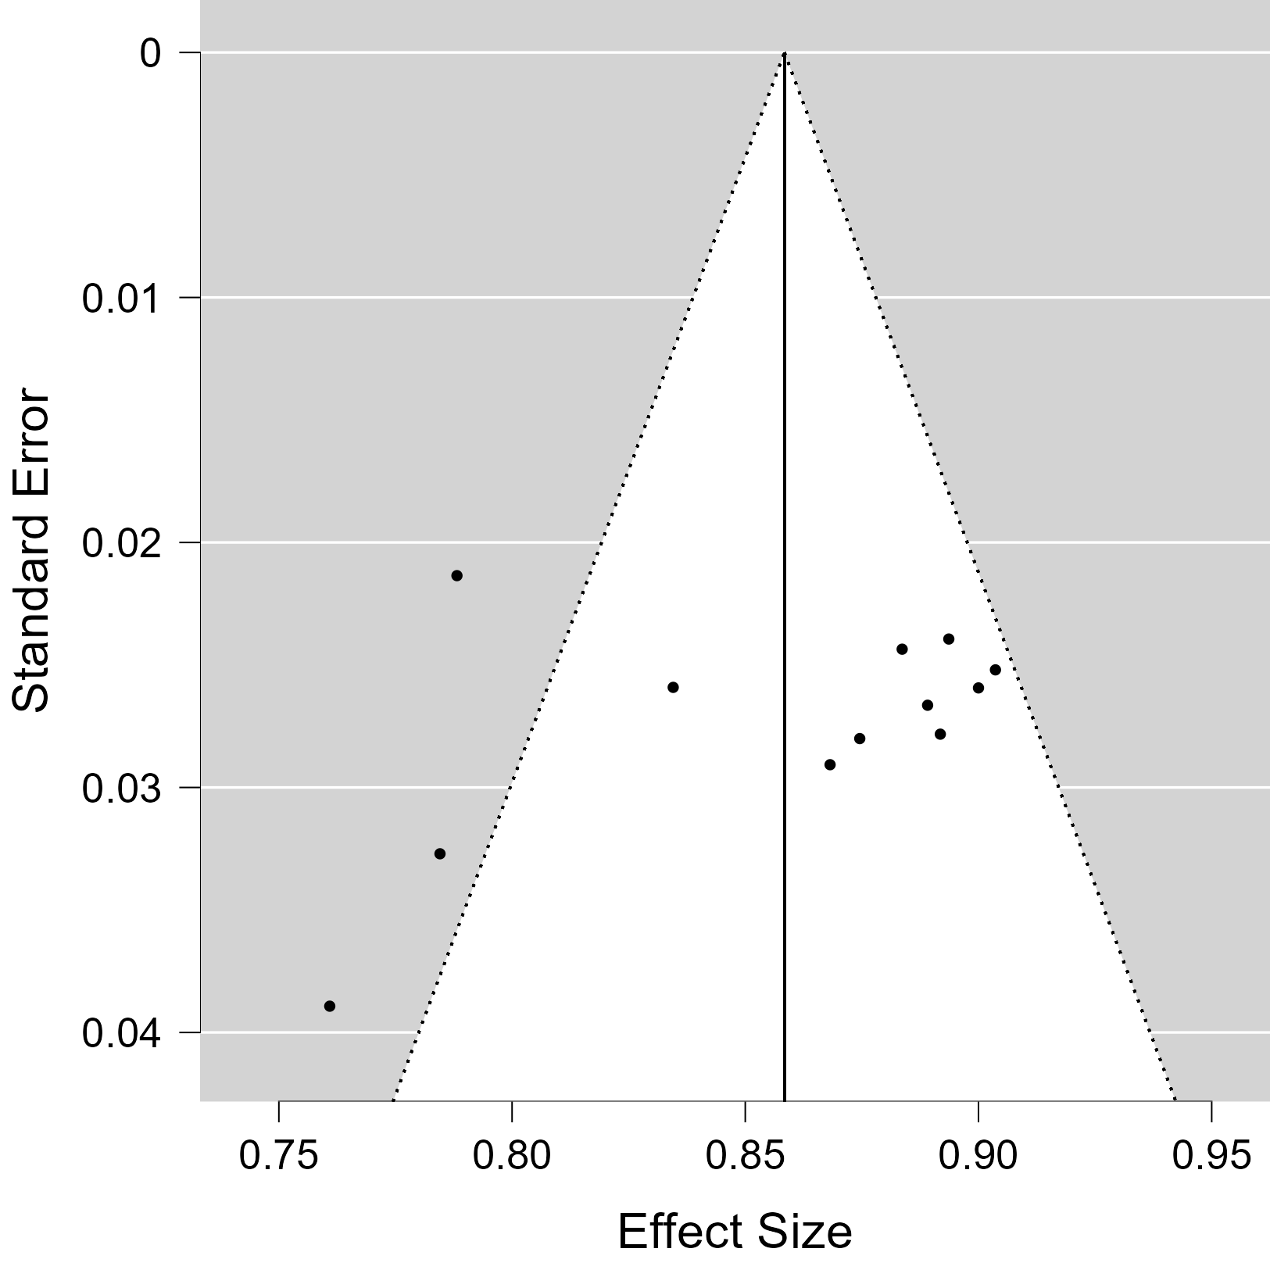
All Models – RE Model Funnel Plot
Notes:
Assessment of Bias: The funnel plot is used to visually assess bias in meta-analysis. Studies should ideally form a symmetrical funnel around the true effect size (typically near the narrow top). Asymmetry in this plot can indicate potential publication bias, where smaller studies that show no or negative results are less likely to be published. Alternatively, asymmetry could result from other biases such as methodological differences, true heterogeneity in study effects, or other factors.

Slide 27

All Models – FE Model Forest Plot – AUC Mean

Slide 28

All Models – FE Model Funnel Plot

Slide 29
All Models – Fixed and Random Effects
Fixed and Random Effects
 |  | Q |  | df |  | p
Omnibus test of Model Coefficients |  | 3449.138 |  | 1 |  | < .001
Test of Residual Heterogeneity |  | 35.216 |  | 11 |  | < .001
Note. p -values are approximate.
Note. The model was estimated using Hedges method.
Notes:
The "Omnibus test of Model Coefficients" shows a statistic of 3449.138 with 1 degree of freedom and a very low p-value (less than 0.001), indicating strong evidence against the null hypothesis.
The "Test of Residual Heterogeneity" has a statistic of 35.216 with 11 degrees of freedom and a p-value less than 0.001, suggesting significant variability that is not accounted for by the model.

Slide 30
All Models – Residual Heterogeneity
Residual Heterogeneity Estimates
 |  |  |  | 95% Confidence Interval
 |  | Estimate |  | Lower |  | Upper
τ² |  | 0.002 |  | 4.504×10⁻⁴ |  | 0.007
τ |  | 0.043 |  | 0.021 |  | 0.081
I² (%) |  | 71.751 |  | 38.696 |  | 90.112
H² |  | 3.540 |  | 1.631 |  | 10.113
Notes:
𝜏^2: This represents the between-study variance in the data, with an estimated value of 0.002.
𝜏: This is the square root of 𝜏^2, indicating the standard deviation of the true effects across studies, with a value of 0.043.
I^2 (%): This statistic measures the percentage of total variation across studies that is due to heterogeneity rather than chance. Here, it is calculated to be 71.751%, indicating high heterogeneity.
𝐻^2: This is the ratio of the total amount of heterogeneity to the amount expected due to sampling error alone, with a value of 3.54.

